Slide 1
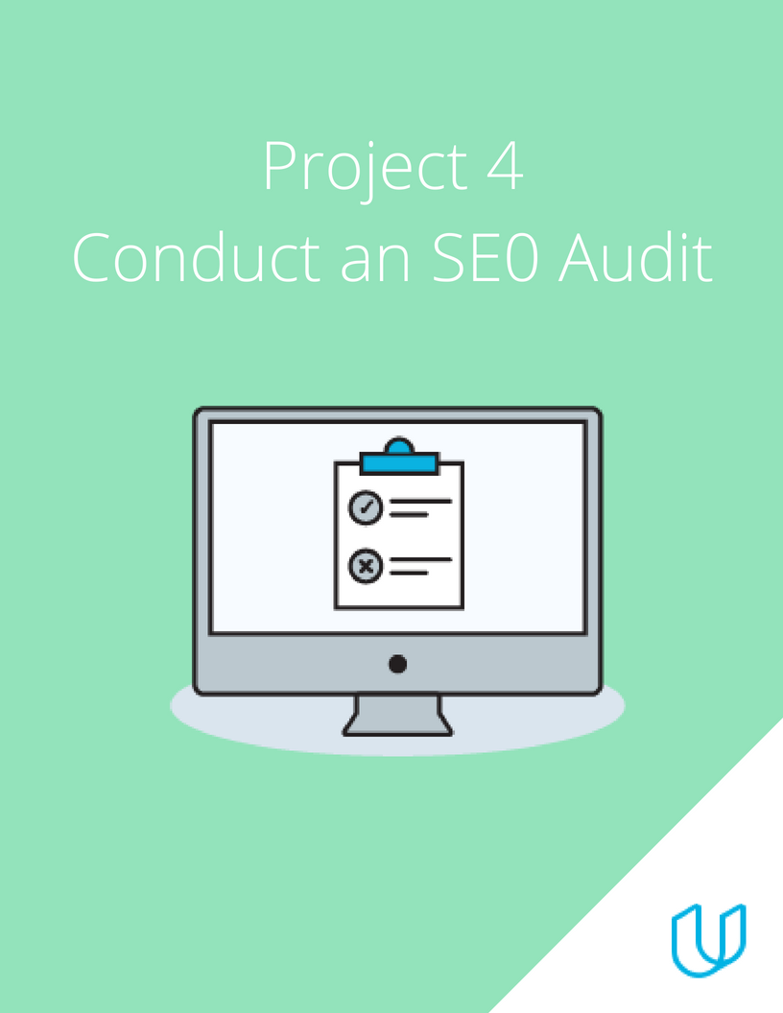
Project 4: SEO Audit

Slide 2
Part 1
Plan your Audit

Slide 3
Marketing Objective & KPI
Marketing Objective – To increase organic serch traffic by 20 percent by September 2022
KPI – click through rate by September 2022

Slide 4
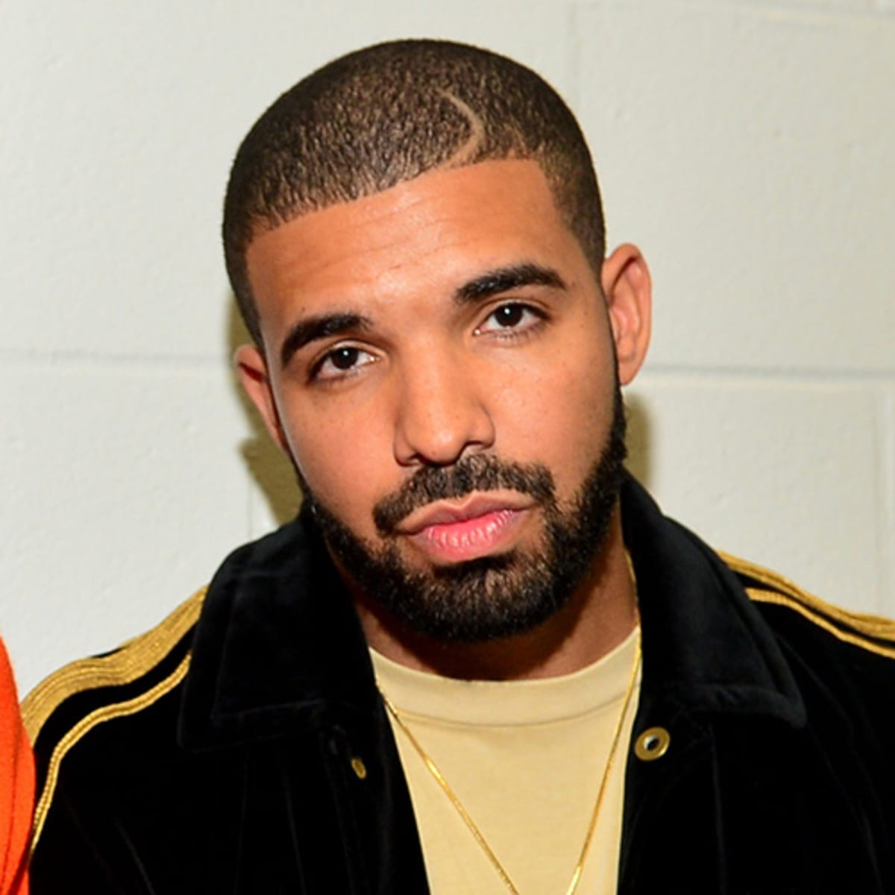
Target Persona
Background and Demographics | Target Persona Name | Needs
AGE: 40 GENDER: Male MARITAL STATUS: Married NUMBER OF CHILDREN: 3 COUNTRY: Nigeria STATE OF RESIDENCE: Edo EMPLOYED: Yes ANNUAL INCOME: 1 million naira HIGHEST CERTIFICATION: Masters Degree | MATTHEW | Sufficient internet network. Projects to practice Digital Marketing. Better work and better cash inflow. Tutorial videos
Hobbies | Goals | Barriers
Play FIFA PES Travel Singing Dancing Chess | A better job Does not see self in this same industry in the next 3 years. Sees self as a high profiled Digital Marketer in the next 3 years. | High cost of data poor Internet Financial constraints Too many responsibilities at work.

Slide 5
Part 2
On Site SEO
Audit

Slide 6
Keywords
Using Moz Keyword Explorer tool, identify the Keywords you might target to drive users to this page. Be sure to use a mix of branded and non-branded Keywords. List 5 head and 5 tail keywords.
 | Head Keywords | Tail Keywords
1 | Digital marketing | Digital marketing certificate
2 | Marketing courses | Digital marketing course
3 | nanodegree | Digital marketing courses
4 | Udacity | Digital marketing jobs
5 | Udacity scholarships | Digital marketing salary

Slide 7
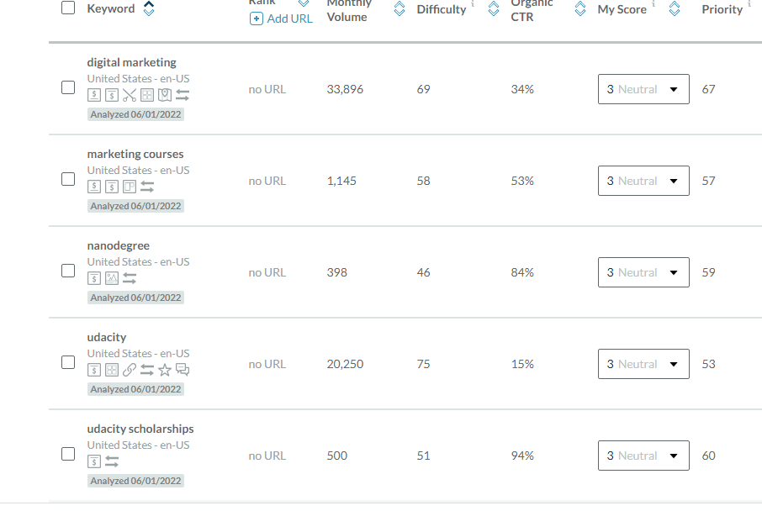
Head screenshot

Slide 8
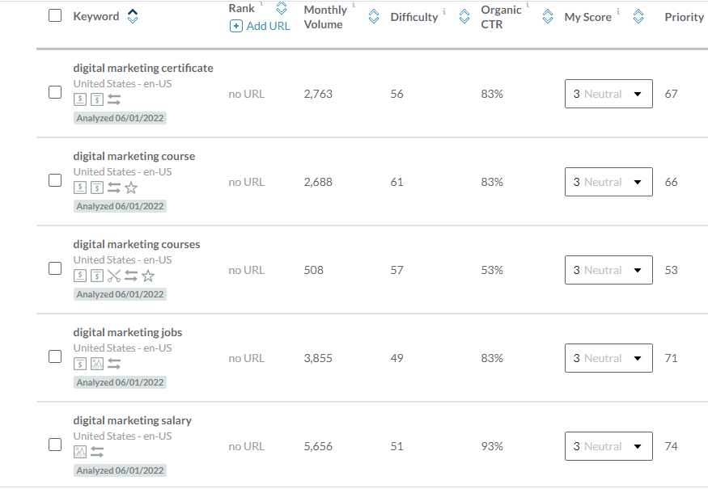
Tail screenshot

Slide 9
Keyword with the Greatest Potential
Head Keyword with the greatest potential?
From my keyword query, the keyword “Digital marketing” has the greatest potential because it has a monthly search volume of 33,896, difficulty of 69 and high click through rate of 34%
Tail Keyword with the greatest potential?
From my keyword query, the keyword “Digital marketing Salary” has the greatest potential because it has a monthly search volume of 5656, low difficulty of 51 and high click through rate of 93%.

Slide 10
Technical Audit: Metadata
url: view-source:https://www.udacity.com/course/digital-marketing-nanodegree--nd018
Current
Title Tag | Digital Marketing Course Online
Meta- Description | Take Udacity digital marketing course online. You will learn SEO, SEM, Google Ads, Email Marketing and Affiliate tactics to maximize traffic and improve online visibility
Alt-Tag 1 | img class="wordmark_logo__2xZEi" src="/images/svgs/udacity-tt-logo.svg" alt="Udacity
Alt-Tag 2 | img src="/images/brand-refresh/mobile-open.svg" alt=""
Alt-Tag 3 | img class="_consumer-schools_schoolIcon__25KX1" src="/images/brand-refresh/school-icons/ai.svg“alt=""
Alt-Tag 4 | img class="_consumer-schools_schoolIcon__25KX1" src="/images/brand-refresh/school-icons/autonomous-systems.svg" alt=""
Alt-Tag 5 | <img class="_consumer-schools_schoolIcon__25KX1" src="/images/brand-refresh/school-icons/cloud-computing.svg" alt=""

Slide 11
url: view-source:https://www.udacity.com/course/digital-marketing-nanodegree--nd018
Revision
Title Tag | Online Digital Marketing Course
Meta- Description | Udacity digital marketing online course will teach you SEO, SEM, Google Ads, Email Marketing and Affiliate tactics to maximize traffic and improve online visibility
Alt-Tag 1 | img class="wordmark_logo__2xZEi" src="/images/svgs/udacity-tt-logo.svg" alt=“logo”
Alt-Tag 2 | img src="/images/brand-refresh/mobile-open.svg" alt=“ open icon"
Alt-Tag 3 | img class="_consumer-schools_schoolIcon__25KX1" src="/images/brand-refresh/school-icons/ai.svg“alt=“ ai"
Alt-Tag 4 | img class="_consumer-schools_schoolIcon__25KX1" src="/images/brand-refresh/school-icons/autonomous-systems.svg" alt=“ autonomous icon"
Alt-Tag 5 | <img class="_consumer-schools_schoolIcon__25KX1" src="/images/brand-refresh/school-icons/cloud-computing.svg" alt=“ cloud icon"

Slide 12
Suggested Blog Topics
Write three Blog topics that incorporate the highest potential Keywords. Include a short summary (150 - 300 words max for each post) as to why you chose those Keyword topics and what you might write about.
Note that you don't have to write these blog posts, just a very brief summary (150 - 300 words max for each post) and a motivation about why you think they would work.
Topic 1 - short explanation
Topic 2 - short explanation
Topic 3 - short explanation

Slide 13
Blog One: An Overview of Digital Marketing
Digital marketing, also called online marketing, is the promotion of brands to connect with potential customers using the internet and other forms of digital communication.
Simply put, digital marketing refers to all marketing efforts that occur on the internet. Businesses leverage digital channels such as search engines, social media, email, and other websites to connect with current and prospective customers. This also includes communication through text or multimedia messages.
Digital marketing is vital for your business and brand awareness. It seems like every other brand has a website. And if they don't, they at least have a social media presence or digital ad strategy. Digital content and marketing is so common that consumers now expect and rely on it as a way to learn about brands.
There are various types of Digital Marketing: -
Search Engine Optimization
Social Media Marketing
Content Marketing
Pay-Per-Click Marketing
Affiliate Marketing
Native Advertising
Marketing automation
Email Marketing
MOTIVATION.
I chose Digital marketing as a head keyword because when compared to other keywords it showed a higher search volume. A lot of people are into business and are concerned with gaining in-demand tech skills like Digital marketing that can help them boost their businesses at the comfort of their homes and one that is less stressful. Hence the higher search volume. A blogpost like this can help them realize what that skill is and what it entails and encourage them to research more on how to get this skill- digital marketing.

Slide 14
Blog Two: Digital Marketing Salary and Benefits
According to payscale, In Nigeria, an early career Digital Marketing Manager with 1-4 years of experience earns an average total compensation (includes tips, bonus, and overtime pay) of ₦1,238,513 based on 36 salaries. A mid-career Digital Marketing Manager with 5-9 years of experience earns an average total compensation of ₦2,280,000 based on 13 salaries.
Digital marketing offers a number of other advantages as well. These are a few of the benefits.
A broad geographic reach
When you post an ad online, people can see it no matter where they are (provided you haven’t limited your ad geographically). This makes it easy to grow your business's market reach.
Cost efficiency
Digital marketing not only reaches a broader audience than traditional marketing but also carries a lower cost. Overhead costs for newspaper ads, television spots, and other traditional marketing opportunities can be high. They also give you less control over whether your target audiences will see those messages in the first place.
Quantifiable results
To know whether your marketing strategy works, you have to find out how many customers it attracts and how much revenue it ultimately drives. With digital marketing, results monitoring is simple. Digital marketing software and platforms automatically track the number of desired conversions that you get, whether that means email open rates, visits to your home page, or direct purchases.
Easier personalization
Digital marketing allows you to gather customer data in a way that offline marketing can't. Data collected digitally tends to be much more precise and specific.
MOTIVATION.
I chose Digital marketing salary as a tail keyword because when compared to other keywords it showed a higher search volume. It is a buzzword used by many people when they think of how well paid a digital marketer is. Individuals are majorly discouraged in becoming a digital marketer because they perceive it entails only social media marketing, hence, less pay and less benefit. Hence, blogpost content like this will encourage people to realize that digital marketing job is a high paying job.

Slide 15
Blog Three: Why You Should Pursue a Career in Digital Marketing.
There are numerous reasons why you should pursue a career in digital marketing, amongst which are these few;
Digital Marketing Is A Lucrative Career
As you enter the digital marketing industry, you can garner a starting salary between 25-35k per month. This is on par with starting salaries in any other industry.
You can demand this salary on the basis of your experience and talent, rather than the number of degrees you have under your belt.
Digital Marketing Is Here To Stay
Back in the 90s, ‘the Internet’ may have seemed to some like a passing fad. We know now that this isn’t true at all! Digital marketing is growing at a rate of 25-30% yearly and shows no signs of slowing. Huge multinational companies like Unilever and P&G now spend a significant proportion of their marketing budgets on digital marketing, and unicorns like Amazon and Zomato spend an even higher proportion.
- Digital Marketing Offers Accelerated Career Growth
For all those who feel that digital marketing is a field with little upward mobility, we beg to differ. Since it is a relatively new field, there are fewer rules and structures. Think about it – there are some digital marketing jobs that are yet to be discovered! So the possibilities for growth are really limitless.
- There’s No ‘One Preferred Role’ In a Digital Marketing Career
Gone are the days when working in an agency was equivalent to being ‘backend support’. Digital marketing agencies are now as mainstream as ever and work with some of the best brands in the country. Also, the possibilities for what role you can assume within a digital marketing agency are endless. And no one role is better than the other.
MOTIVATION.
I chose Digital marketing because when compared to other keywords it showed a higher search volume. On top of that, a lot of people interested in tech are confused on which path to take. Also, a lot of persons have heard about Digital marketing but don’t have enough motivation to go ahead and pursue a career in it. Hence, a blogpost like this will direct them to start seeing digital marketing as a potential course and one that can result in a worthwhile career.

Slide 16
Part 3
Off-Site SEO

Slide 17
Technical Audit: Backlink Audit
 | Backlink | Domain Authority (DA)
1 | azure.microsoft.com/en-us/blog/announcing-advanced-azure-machine-learning-nanodegree-program-with-udacity/ | 99
2 | xd.adobe.com/ideas/career-tips/online-ux-design-courses-bootcamps/ | 97
3 | www.cloudflare.com/en-in/case-studies/udacity/ | 98

Slide 18
Link-Building
Using the SEMRush or SE Ranking tool and research, strategize a link-building campaign.
Identify three websites that you think would be relevant, high traffic sites that you would like to gain backlinks from to help drive traffic to Udacity’s or your company’s page.
Site name | Vanguard
url | https://www.vanguardngr.com/
Organic traffic | 6,5m
Site name | Linda Ikeji Blog
url | https://www.lindaikejisblog.com/
Organic search traffic | 149,7K
Site name | netnaija
url | https://www.thenetnaija.com/
Organic search traffic | 14,5k

Slide 19
Part 4
Performance
Testing

Slide 20
Site Performance Audit: Performance Tests
For each of the submissions, please take a screenshot of your results and post your screenshot on your submission presentation.
Using the Northcutt or any other tool, research how many of Udacity’s website or your company’s pages are indexed by Google.
Using the Google Page Speed Insights tool, perform a speed test of udacity.com’s or your company’s mobile presence.
Using the Think with Google tool, assess the mobile-friendliness of the udacity.com site or your company’s website.

Slide 21
Page Index
Using the https://seomagnifier.com/google-index-pages-checker/ I found out that the pages index for udacity.com is 6,140 pages.
Explain why the number of pages indexed is important.
Number of pages indexed is important because it gives your page more traffic and whenever you post any new content, it will be discovered more quickly.

Slide 22
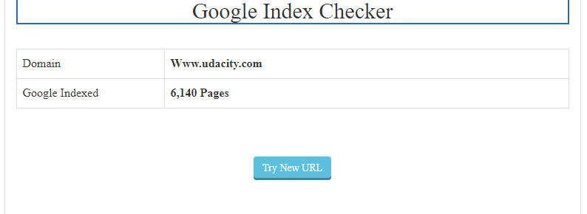
Google index page screenshot

Slide 23
Page Speed
Using the Google Page Speed I found that the speed for Udacity mobile was 34/100 and for desktop was 90/100
Explain why evaluating the Page Speed is important.
Page speed test is important to users because, well, faster pages are more efficient and it provides a much better on-page user experience

Slide 24
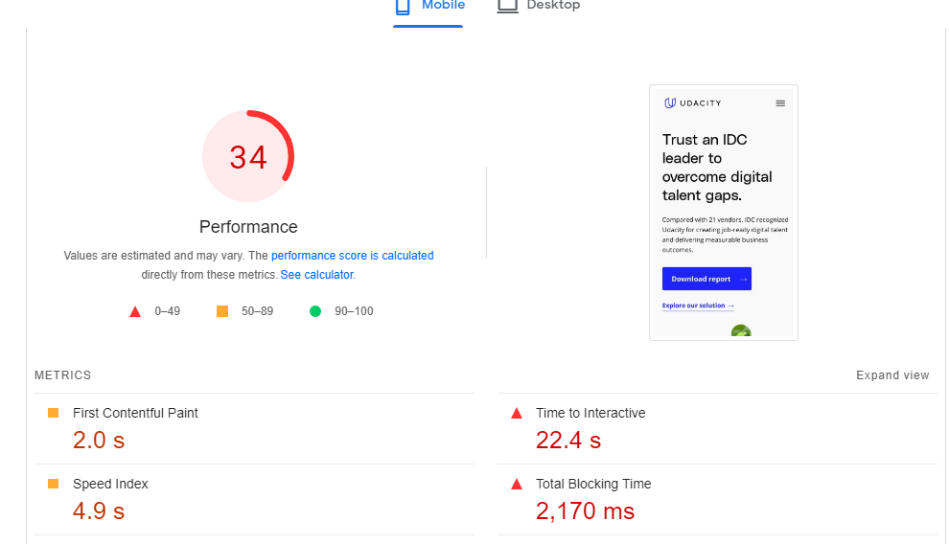
Mobile page speed

Slide 25
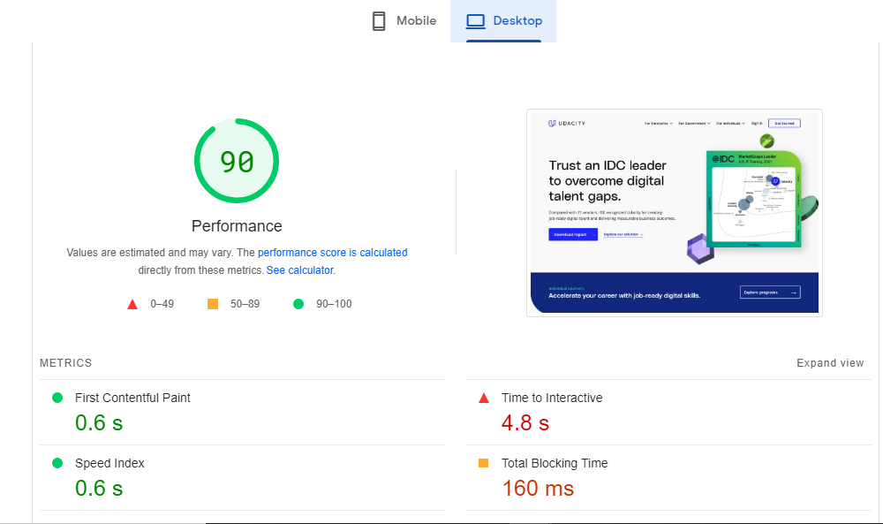
desktop page speed

Slide 26
Mobile-Friendly Evaluation
Using the Think with Google tool I found out that udacity mobile site speed is 2.4 seconds in United States on a 4G connection.
Explain why having a mobile-optimized is Important.
Having a mobile optimized is important because it makes sure to properly display on smaller screens. Also, it makes the site much easier to navigate. It reformats content, displays larger navigation buttons and optimizes images according to screen size.

Slide 27
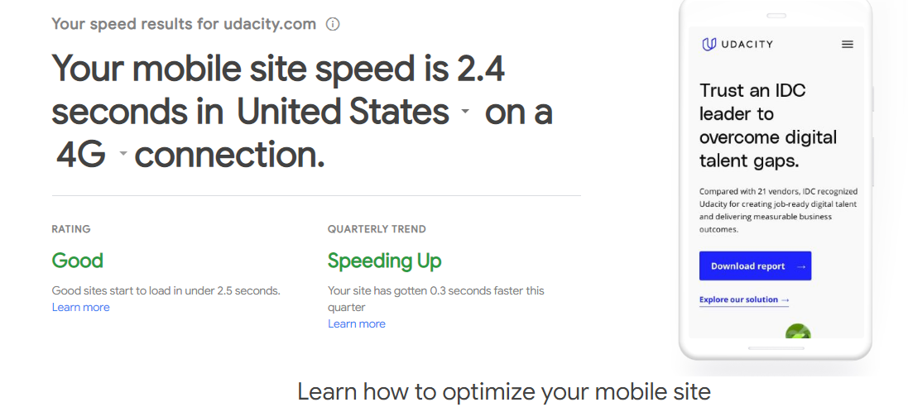
Mobile optimization

Slide 28
Part 5
Recommendations

Slide 29
Recommendations
I experienced slowness in the speed of the mobile version of the Udacity site (34%), as opposed to the desktop speed (90%). This is bad as a lot of persons use mobile devices more when searching he internet. This kind of slowness can affect user’s mobile experience, thereby discouraging the person from waiting till he information he/she needs pops up. Hence, a drastic increase in their bounce back rate. I suggest this be resolved by developers of the Udacity mobile page. The load time should be 0.1seconds. Also, they should set an explicit width and height on image elements to reduce layout shifts and improve CLS, reduced JavaScript execution time and ensure main thread work is minimized.
The 3 websites mentioned for Link building have very high organic traffic, hence, a good platform for advert. We could reach out to them to place a Udacity advert on their pages. Also, we could suggest they make a blogpost about Udacity courses, especially the Digital Marketing Nanodegree, as some of their subscribers could be business owners or in need of a tech skill.
The meta description of the Udacity Digital marketing nanodegree page should be modified to be more descriptive and concise. Blogposts I made can be featured in order to attract more traffic to the site.

